Slide 1

Optimizing Return of Investments: Identifying the Most Profitable Property Type and Neighbourhoods for Short-stay Rentals in New York
Business Analysis by Patricia May Reyes
RMITO Business Analytics and Visualisation
Notes:
Welcome to the business analysis and visualization project on optimizing return on investments in the short-stay rental market in New York.

Slide 2

Which property type and neighbourhood combination offers the highest potential return on investment for short-stay rentals in New York?
The purpose of this business analysis project was to gain insights into the New York short-stay rental market using Airbnb listings data.
The analysis considered factor such as neighbourhood popularity, preferences on property type and room type, selling points, and pricing dynamics.
Notes:
The analysis aims to answer the business question:
Which property type and neighbourhood combination offers the highest potential return on investment for short-stay rentals in New York?
(read the whole slide)

Slide 3
Ethical and Legal Considerations on Data Privacy
Exclusion of Host identities to maintain privacy and confidentiality
Exact addresses of each property are not disclosed to protect the security of hosts and guests
By implementing these ethical and legal considerations, the analysis prioritizes data security and anonymity.
Notes:
In this business analysis, we place a strong emphasis on data privacy to protect the personal information of hosts and guests.
(read the whole slide)

Slide 4
Data Cleaning Checklist | New York Listing Dataset
1. Create a backup copy. | Done
2. Check the format of your data. | Done
2.1 Is it in tabular format? | Yes
2.2 Are all the rows and columns showing? | Yes
3. Spell Check. | Yes
3. 1 Identify and correct any inconsistencies or typos in the data. | Not Applicable
4. Text check - find | Not Applicable
5. Text Check - change cases | Yes
5.1 Check that data formats are consistent across the dataset. | Change DUMBO to Dumbo
6. Check records with spaces or non-printing characters in the data. | Change spaces in the STATE column to NY
7. Remove duplicate records in the dataset. | No duplicates found
8. Are there any merging and splitting done? | Not Applicable
Data Cleaning Checklist
Notes:
To ensure my data is clean and ready for analysis, I have followed my data cleaning checklist. For further information, you can verify the checklist on this slide.

Slide 5

What is the most popular neighborhood in New York?
Notes:
Change to Tableau Dashboard

Slide 6
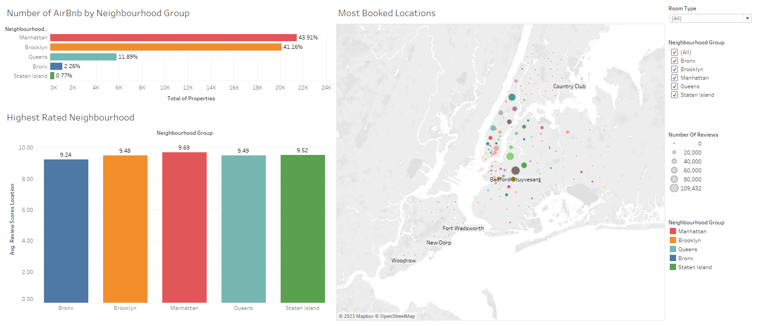
Notes:
The analysis reveals that Manhattan emerges as the most popular neighborhood group with 43.91% of listings. Following closely behind is Brooklyn, which also boasts a significant number of 41.16%.
When it comes to guest satisfaction, properties across all neighborhood groups in New York receive high review scores. However, Manhattan takes the lead with the highest average review score of 9.69.
Turning our attention to the most booked locations, our analysis reveals that Bedford-Stuyvesant in Brooklyn stands out as the top choice. This neighborhood garners high engagement from renters, as evidenced by the significant number of reviews.

Slide 7

What are the popular Room Types and Property Types in New York?

Slide 8
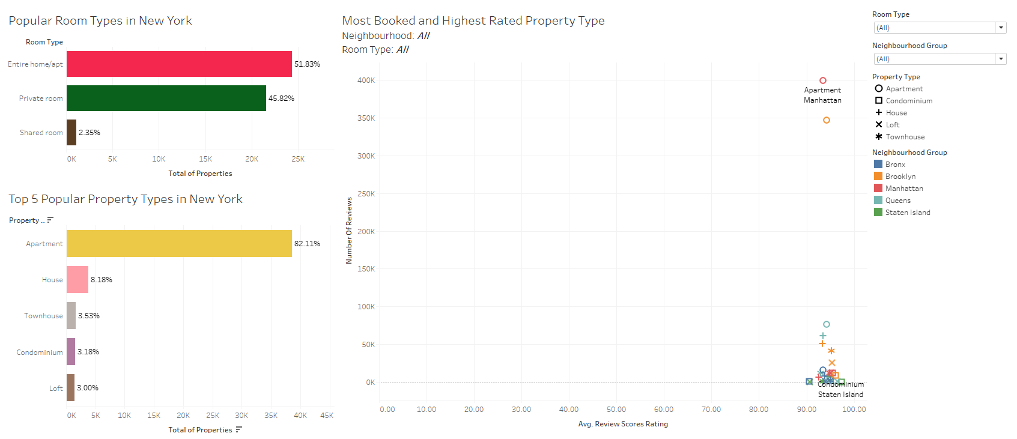
Notes:
The analysis reveals that the most of short-stay rentals in New York are categorized as Entire Home/Apt, representing a significant 51.83% of the listings. This indicates that travelers prefers to have an entire space to themselves.
Shifting our focus to property types, apartments emerge as the dominant choice among short-stay rentals in New York. They account for an impressive 82.11% of the listings.
Our analysis also showcases the engagement levels and average review scores for various neighborhood groups and their top property types. Apartments in Manhattan stands out with an engagement level of 399,311 reviews and an impressive average rating of 93.52%. On the other hand, in Staten Island, Condominiums may have a lower engagement level of only 12 reviews, but they received the highest rating score of 97.33%. This demonstrates that even with fewer bookings, the quality and satisfaction of guests are exceptionally high in this neighborhood.

Slide 9

What are the selling points of the short-stay rentals in New York?

Slide 10
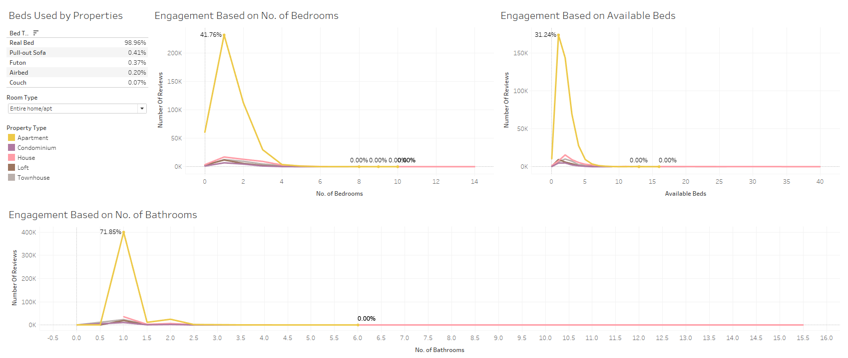
Notes:
One of the selling points of short-stay rentals in New York is the preference for real beds with 98.96% of properties provide real beds for guests.
When it comes to engagement levels based on the number of bedrooms, our analysis shows that one-bedroom apartments capture the highest engagement at 41.76%. This suggests that guests are mostly single or couple who prefers small rentals, making it an attractive option for their short-stay rental needs.
Another selling point is the availability of beds within the apartments. Apartments offering one bed generate the highest engagement rate at 31.24%. This indicates that guests value the convenience and comfort of having a dedicated bed space during their stay.
Our analysis also highlights the engagement levels based on the number of bathrooms. Apartments with one bathroom garner the highest engagement, accounting for a significant 71.85%. This suggests that guests are comfortable with a single bathroom setup.

Slide 11

What is the average nightly rate in short-stay rentals in New York City?

Slide 12
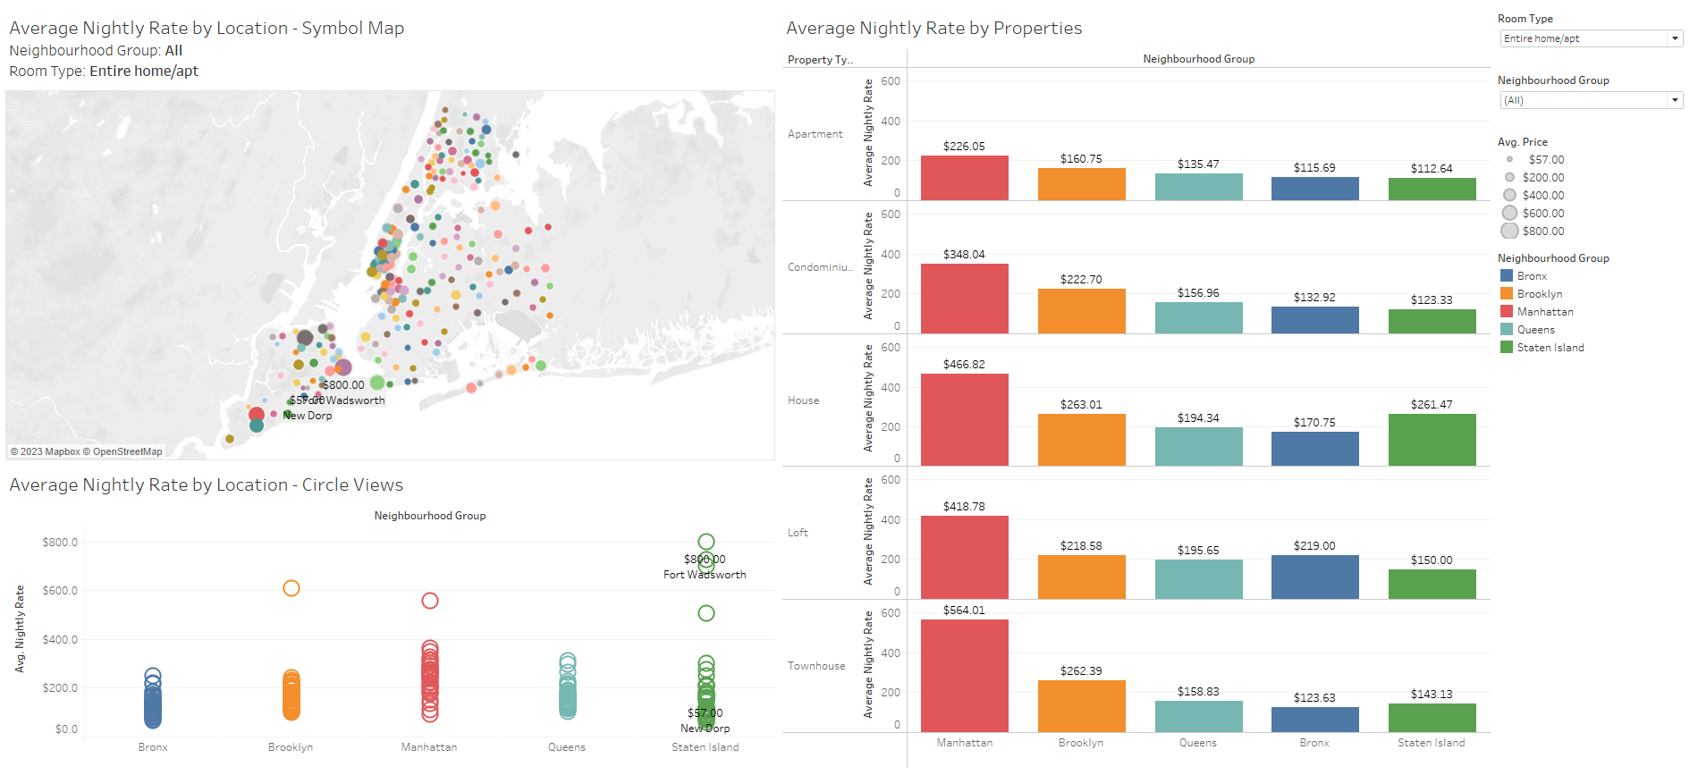
Notes:
The symbol map showcases the variations in pricing, highlighting areas with higher or lower average nightly rates in New York City. It offers a comprehensive view of how pricing differs across different neighborhoods and serves as a valuable reference for understanding the pricing dynamics in the city.
Moving on to our next visualization, we have a chart using circle views that displays the average nightly rates by neighborhood groups in New York City. Our analysis reveals that rentals in Staten Island tend to be more expensive compared to other neighborhood groups. One specific highlight is Fort Wadsworth in Staten Island, which stands out with the highest average nightly rate of $800.00, reflecting the premium nature of accommodations in that area.
Our analysis also delves into the pricing dynamics within different neighborhoods by examining the average nightly rates of different property types. This chart provides insights into how pricing varies across property types within each neighborhood group. In this chart, we can see clearly that nightly rate of properties in Manhattan are pricier compared to other neighbourhood groups.

Slide 13

What is the average monthly revenue of short-stay rentals in New York?

Slide 14
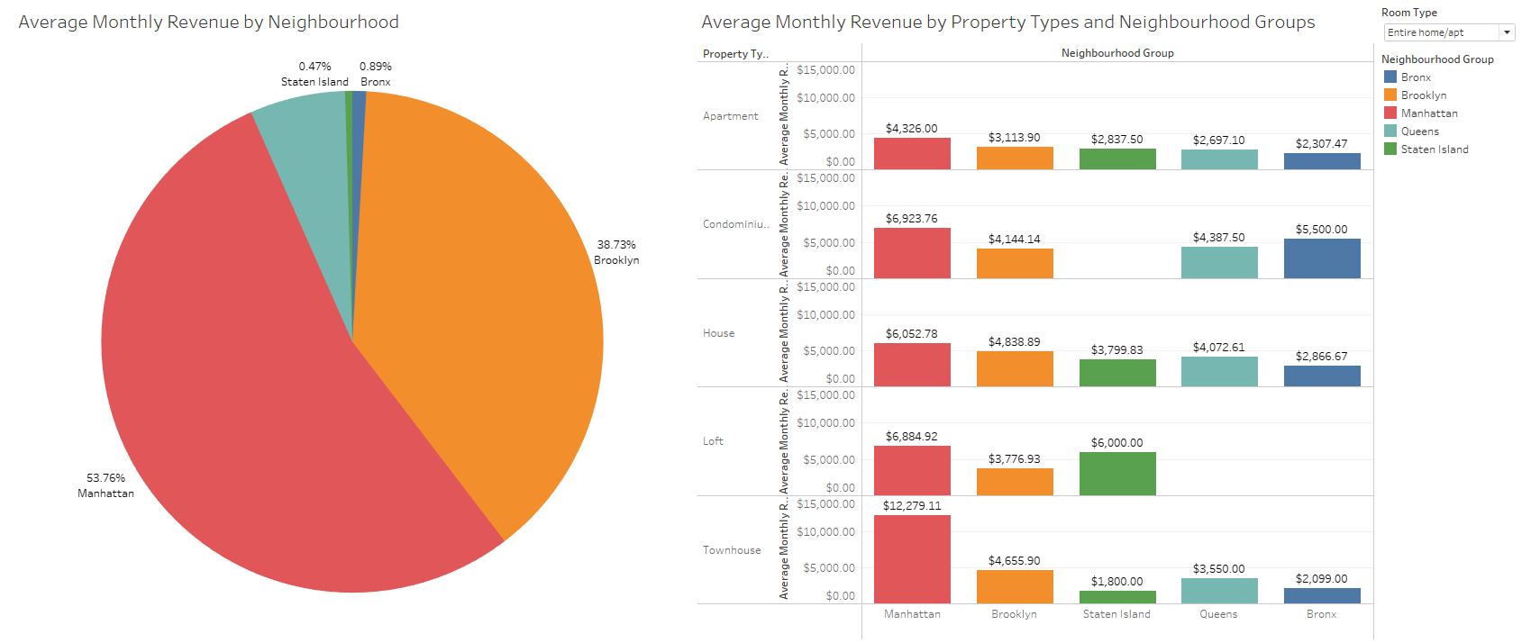
Notes:
Our analysis reveals that a significant portion of New York's monthly revenue in Airbnb listings is concentrated in Manhattan, accounting for a substantial 53.76% of the total revenue. Following closely behind is Brooklyn, capturing 38.73% of the revenue. This pie chart offers a visual representation of the revenue distribution across neighborhoods, emphasizing the dominance of Manhattan and Brooklyn in the short-stay rental market.
Further supporting the revenue dominance of Manhattan and Brooklyn, our analysis unveils additional insights through a bar chart. While Townhouses in Manhattan may have the highest monthly revenue, it is crucial to note that previous charts showcased more engagement in apartments in Manhattan. This highlights the nuanced dynamics within neighborhoods, where certain property types drive higher revenue despite others demonstrating higher levels of engagement.

Slide 15

Conclusion
The analysis reveals that Manhattan is the most popular neighbourhood group for short-stay rentals in New York, with high engagement levels and positive guest reviews.
Brooklyn follows closely behind, showcasing its popularity among travellers. Bedford-Stuyvesant in Brooklyn emerges as the most booked location, offering an attractive alternative to Manhattan.
The preferences and trends indicate that travellers prefer Entire Home/Apt for room types and apartments dominate the property types.
Selling points include the preference for real beds, the appeal of one-bedroom apartments, and the availability of beds and bathrooms to accommodate different group sizes.
Pricing dynamics highlight variations across locations and neighbourhood groups, with higher rates in Staten Island.
The average monthly revenue distribution emphasizes the dominance of Manhattan and Brooklyn. Townhouses in Manhattan generate the highest revenue, but it is important to consider engagement levels and property types within neighbourhoods.
These insights provide valuable guidance for investors and property owners seeking the highest return on investment in New York's short-stay rental market.

